Slide 1

Exploiting POI-Specific Geographical Influence for Point-Of-Interest Recommendation
Hao Wang, Huawei Shen, Wentao Ouyang and Xueqi Cheng
Institute of Computing Technology, Chinese Academy of Sciences

Slide 2
Outline
1. Introduction
2.Motivation
3. Model
4. Experiments
5. Conclusion

Slide 3





Introduction
Background
Location-based social networks (LBSNs)
Users can check-in Point-of-Interest (POIs) in LBSNs
(Summer palace)
Point-of-interest
User

Slide 4


Introduction
Background
LBSNs become popular
POI information overload for users
Point-of-Interest recommendation
Website / App | #Active users | #Check-ins
Foursquare | 50 million | 8 billion
Yelp | 21 million | 102 million
Statistics of Foursquare and Yelp by 2016
Interesting but unvisited POIs
User

Slide 5
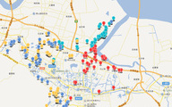

Motivation
A main challenge: Geographical influence in POI recommendation
Related works
Insight: Geographical clustering phenomenon of users’ check-ins
Model: Parameterized distributions
Typical papers: Cheng et al., AAAI 2012, Ye et al., SIGIR 2011, Liu et al., CIKM 2014
Users’ preference

Slide 6
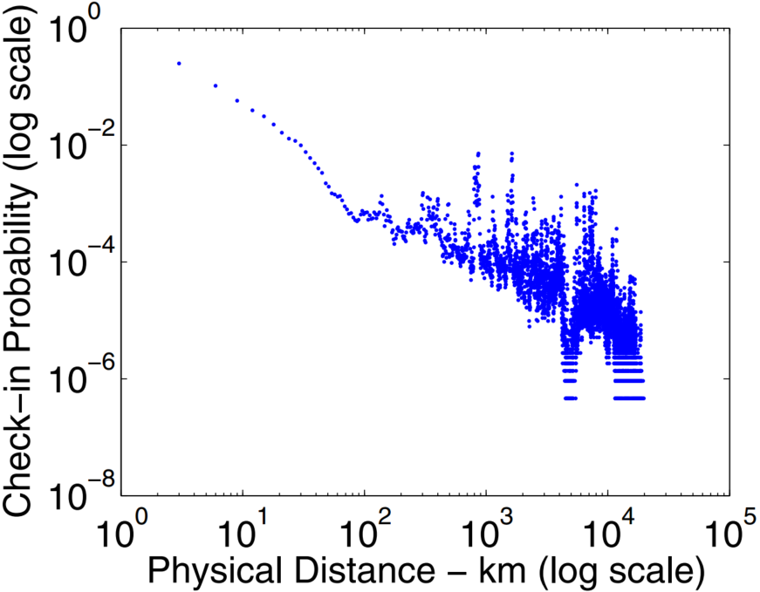
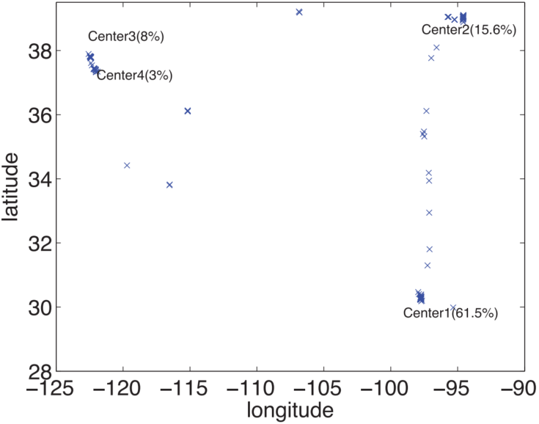
Motivation—existing typical methods
Cheng et al., AAAI 2012
Ye et al., SIGIR 2011
Longitudes and latitudes ~ Multi-Center Gaussian distribution
POI correlation vs. distance: Power-law function
Check-in instance, POI
latitude
probability
longitude
Distance between POIs
A user’s check-in distribution
Geographical influence probability distribution

Slide 7
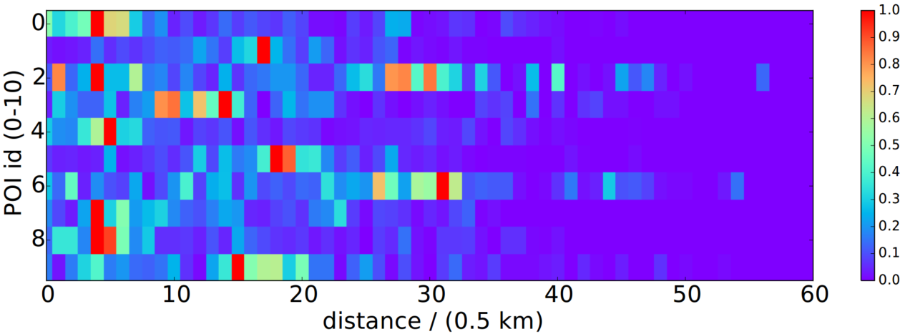
Motivation
Summary
Existing methods focus on distance only
Fail to capture High variation and asymmetry of geographical influence
Degree of correlation
POI id
distance
Our insight: Geographical influence should be POI-specific!

Slide 8
Model
Formulation
Input
A user set 𝑈
A POI set 𝐼
Users’ check-in history 𝐻
Locations of POIs
Output
A POI list for each 𝑢∈𝑈
Model overview—GeoIE
POI-specific geographical influence
User preference score
Observed check-ins

Slide 9


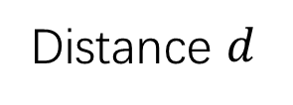
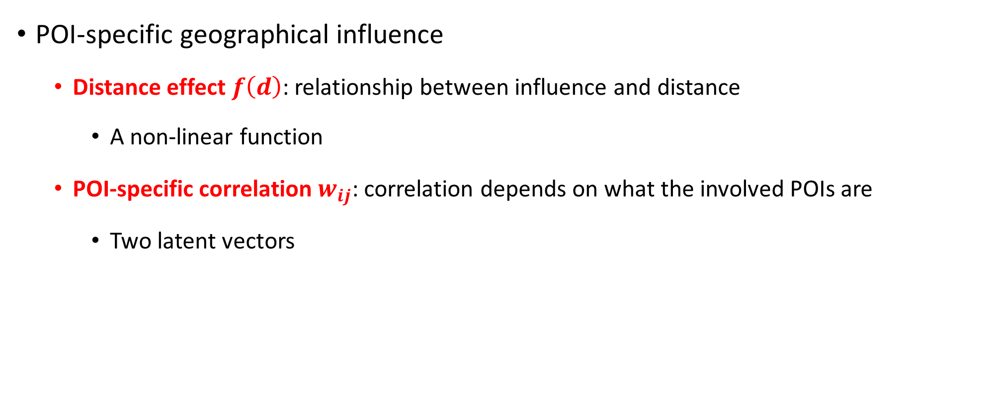
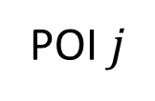
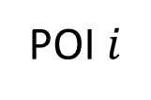
Model
POI-specific geographical influence
Distance effect $f\left(d\right)$: relationship between influence and distance
A non-linear function
POI-specific correlation $w_{ij}$: correlation depends on what the involved POIs are
Two latent vectors
Distance $d$
POI $i$
POI $j$

Slide 10
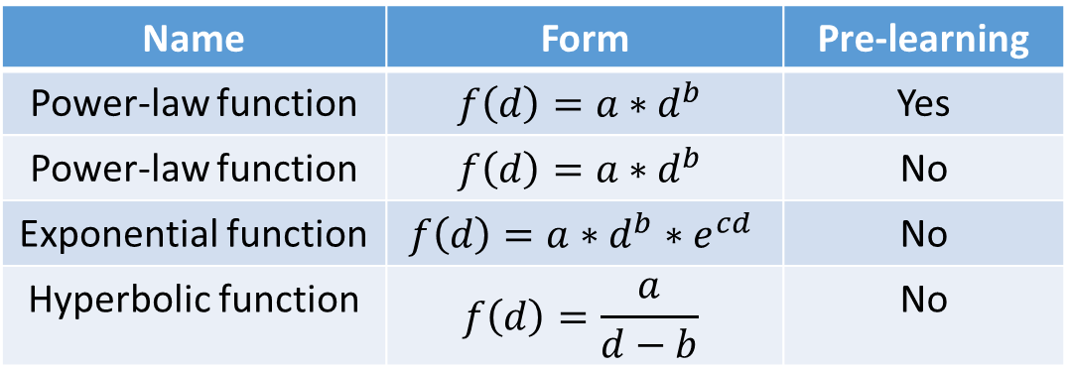

Model
POI-specific geographical influence
Distance effect $f\left(d\right)$: relationship between influence and distance
Four types of non-linear distance functions
Name | Form | Pre-learning
Power-law function | $$f\left(d\right)=a∗d^{b}$$ | Yes
Power-law function | $$f\left(d\right)=a∗d^{b}$$ | No
Exponential function | $$f\left(d\right)=a∗d^{b}∗e^{cd}$$ | No
Hyperbolic function | $$f\left(d\right)=\frac{a}{d−b}$$ | No

Slide 11


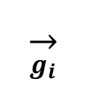
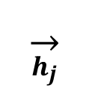
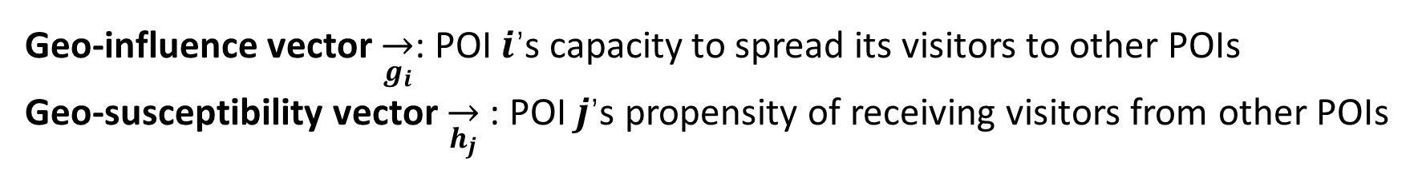
Model
POI-specific geographical influence
POI-specific correlation $w_{ij}$: correlation depends on what the involved POIs are
Two latent vectors $\overset{→}{g}$ and $\overset{→}{h}$
Geo-influence vector $\overset{→}{g_{i}}$: POI 𝒊’s capacity to spread its visitors to other POIs
Geo-susceptibility vector $\overset{→}{h_{j}}$: POI 𝒋’s propensity of receiving visitors from other POIs
$$w_{ij} ={\overset{→}{g_{i}}}^{T} \overset{→}{h_{j}}$$
$$\overset{→}{g_{i}}$$
$$\overset{→}{h_{j}}$$
Notes:
subway stations generally have high geo-influence restaurants usually have high geo-susceptibility

Slide 12
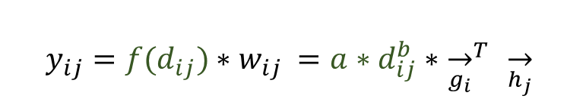
Model
POI-specific geographical influence
POI-specific correlation
$$y_{ij}=f(d_{ij})∗w_{ij} =a∗d_{ij}^{b}∗{\overset{→}{g_{i}}}^{T} \overset{→}{h_{j}}$$
Distance effect
Two benefits:
Capture the asymmetric and high variation of geographical influence
Two low-dimensional vectors for each POI significantly avoid overfitting

Slide 13
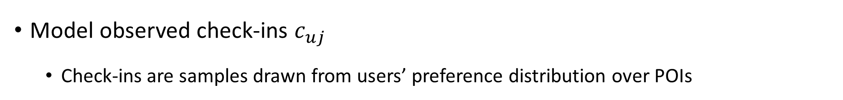
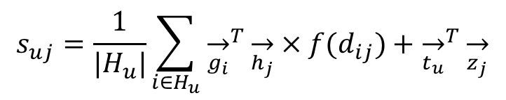

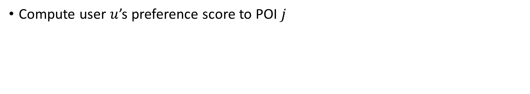
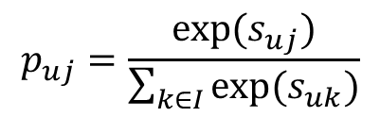
Model
Compute user $u$’s preference score to POI $j$
$$s_{uj}=\frac{1}{|H_{u}|}\sum_{i∈H_{u}}{{\overset{→}{g_{i}}}^{T}\overset{→}{h_{j}}×f(d_{ij})}+{\overset{→}{t_{u}}}^{T}\overset{→}{z_{j}}$$
Model observed check-ins $c_{uj}$
Check-ins are samples drawn from users’ preference distribution over POIs
$$p_{uj}=\frac{exp(s_{uj})}{\sum_{k∈I}{exp(s_{uk})}}$$
$$c_{uj}\sim \{p_{u}\}$$

Slide 14
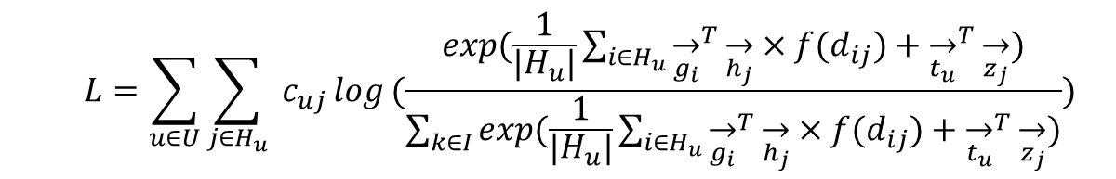
Model
Objective function
Optimization
stochastic gradient ascent algorithm + negative sampling
Recommendation
Recommend top-n POIs with highest scores
$$L=\sum_{u∈U}{\sum_{j∈H_{u}}{ c_{uj}}log}(\frac{exp(\frac{1}{|H_{u}|}\sum_{i∈H_{u}}{{\overset{→}{g_{i}}}^{T}\overset{→}{h_{j}}×f(d_{ij})}+{\overset{→}{t_{u}}}^{T}\overset{→}{z_{j}})}{\sum_{k∈I}{exp(\frac{1}{|H_{u}|}\sum_{i∈H_{u}}{{\overset{→}{g_{i}}}^{T}\overset{→}{h_{j}}×f(d_{ij})}+{\overset{→}{t_{u}}}^{T}\overset{→}{z_{j}})}})$$

Slide 15
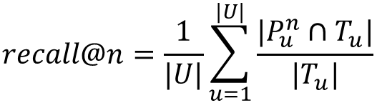
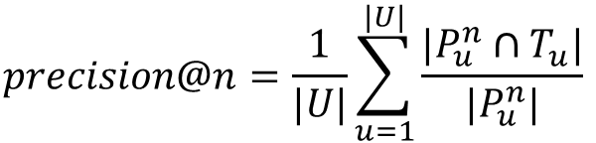
Experiments
Datasets: two real-world datasets
Metrics
Dataset | #Users | #POIs | #Check-ins
Foursquare | 6,118 | 88,193 | 172,961
Gowalla | 1,624 | 3,585 | 115,890
$$precision@n=\frac{1}{|U|}\sum_{u=1}^{|U|}{\frac{|P_{u}^{n}∩T_{u}|}{|P_{u}^{n}|}}$$
$$recall@n=\frac{1}{|U|}\sum_{u=1}^{|U|}{\frac{|P_{u}^{n}∩T_{u}|}{|T_{u}|}}$$

Slide 16
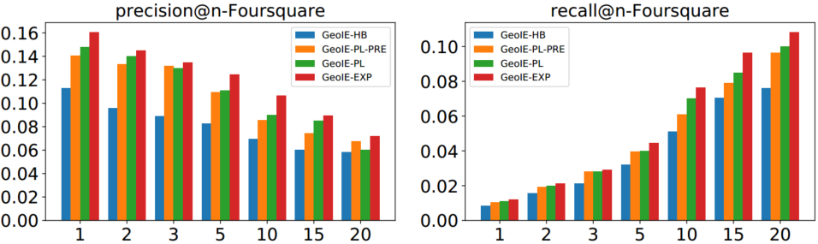
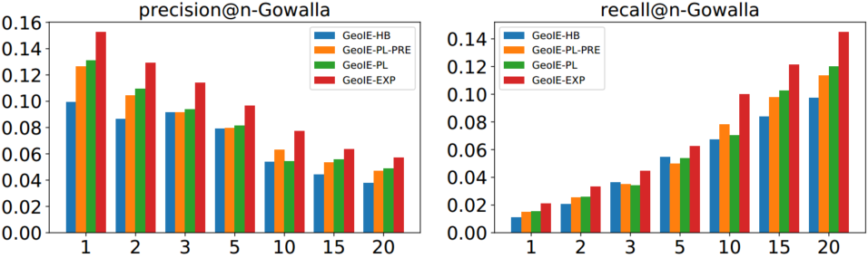
Experiments
E1: GeoIE and its variants in 4 types of geographical influence functions
Exponential function achieves the best performance,
since it has the most parameters

Slide 17
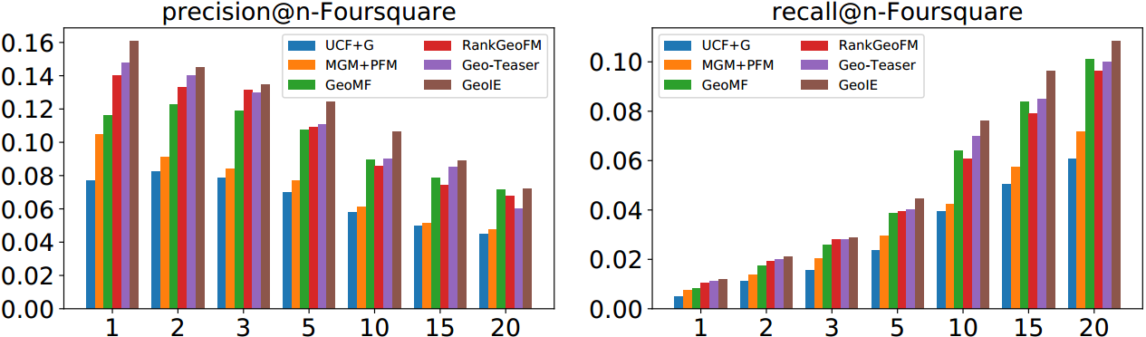
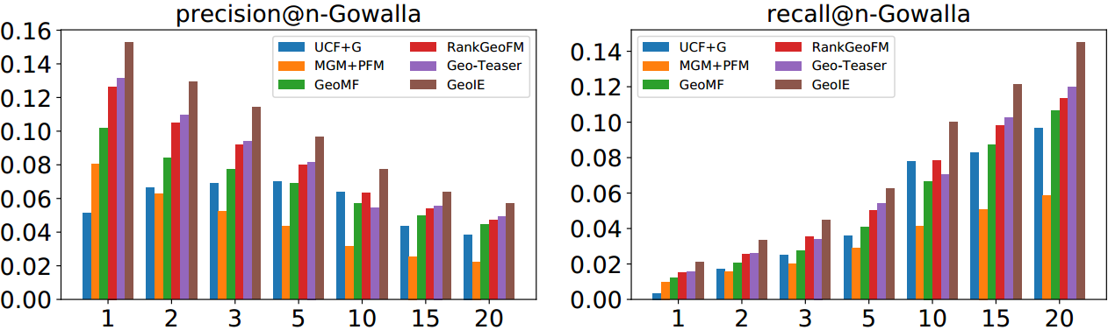
Experiments
E1: GeoIE and state-of-the-art methods
UCF+G (Ye-SIGIR-2011)
MGM+PFM (Cheng-AAAI-2012)
GeoMF (Lian-KDD-2014)
RankGeoFM (Li-SIGIR-2015)
Geo-Teaser (Zhao-WWW-2017)
GeoIE (Our method)
The proposed GeoIE beats all baseline methods,
since we model POI-specific geographical influence

Slide 18
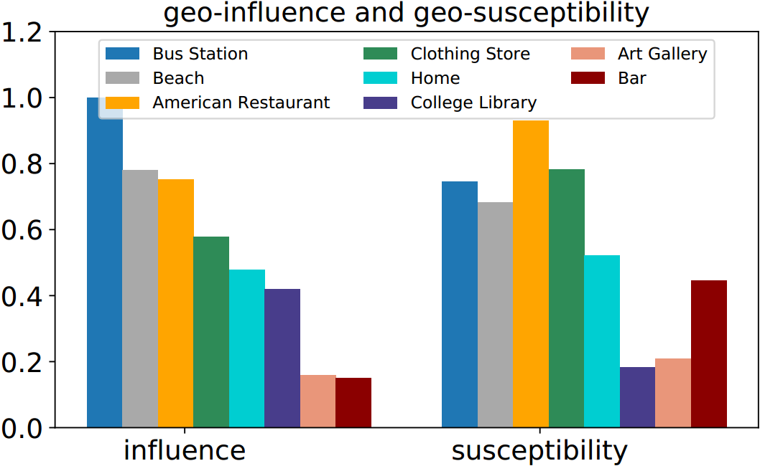
Experiments
E3: Different categories of POIs’ geo-influence and geo-susceptibility vectors
Norm of vector
The geo-influence and geo-susceptibility of different categories of POIs are highly variable

Slide 19
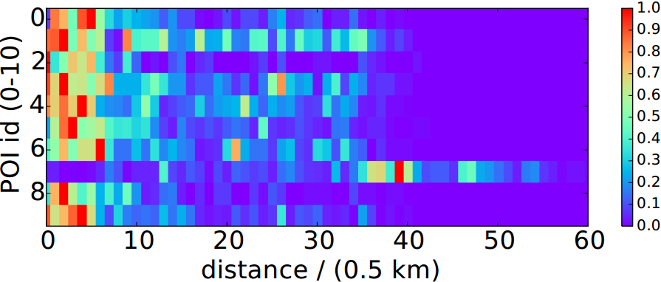
Experiments
E2: POI correlation with and without geo-influence and geo-susceptibility
POIs’ correlation over distance becomes much smoother

Slide 20
Conclusions
Geographical influence is POI-specific
Through a case study, we find the existence of POI-specific geographical influence
It depends on both distance effect and POI-specific correlations
POI-specific correlation is modeled by two latent vectors
Two real-world datasets to evaluate the effectiveness of the proposed method

Slide 21
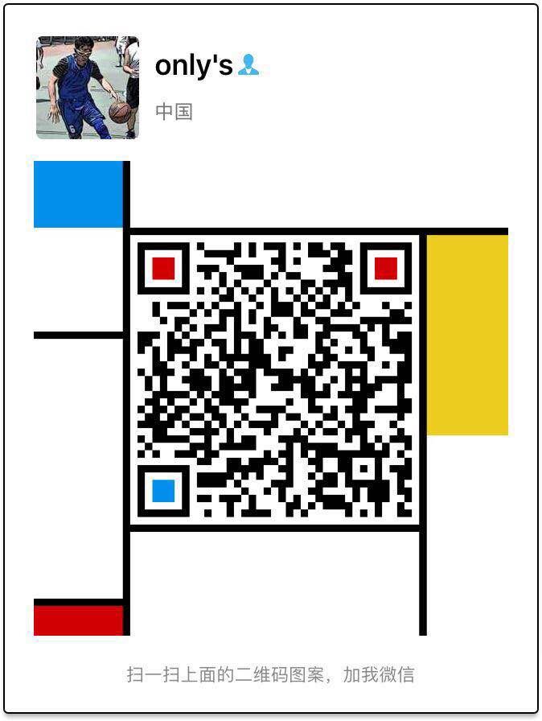
Thank You！
Question
way.wh@outlook.com

